Slide 1
Unit 7:
Africa South of the Sahara
Chapter 20:
The Land
Climate & Vegetation

Slide 2
Basic facts
Immense region
Bordered by Atlantic Ocean to West, Indian Ocean to East
Red Sea/Gulf of Aden separate Africa from Arabian Peninsula in Asia

Slide 3
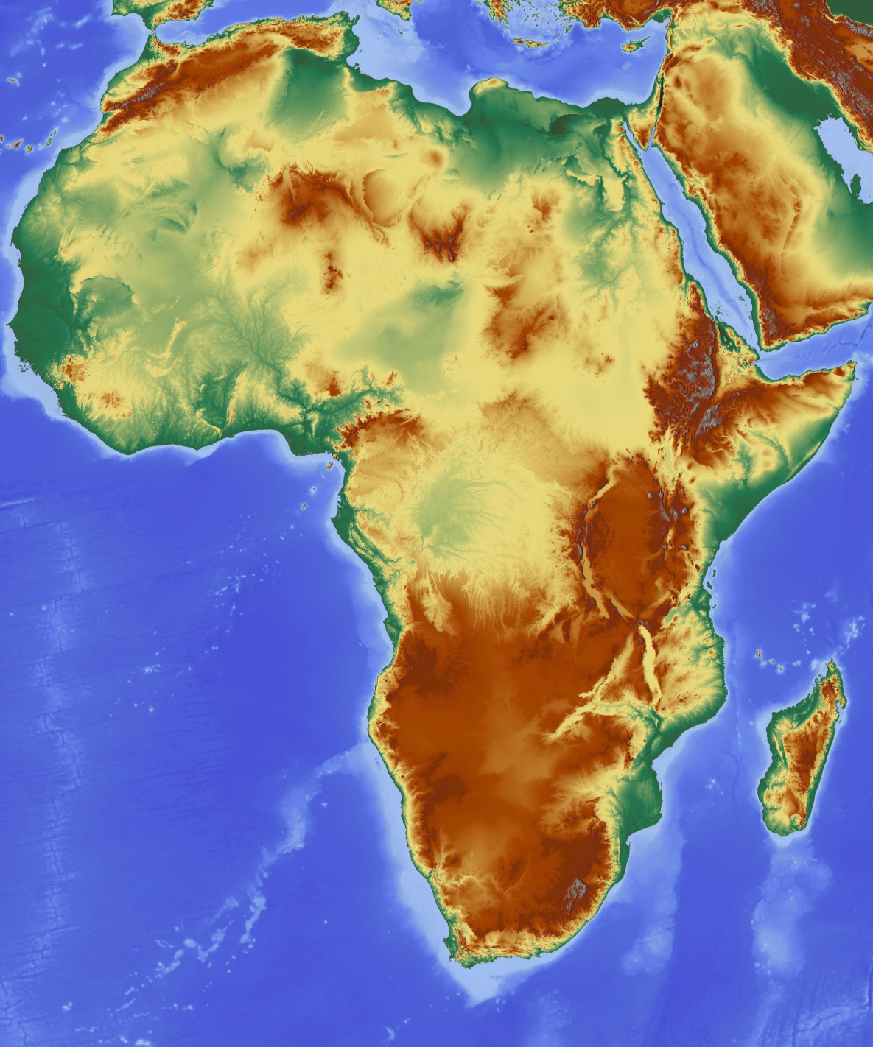

Slide 4
Plateaus, Highlands, & Mountains
Africa South of the Sahara series of steps
  Edges of continent at low elevation for up to 20 miles
    This runs into seep ESCARPMENTS—jagged slopes or cliffs
    Africa continent thus looks like giant plateau
      Rivers that cross ESCARTMENTS plunge off into massive waterfalls, or CATARACTS
        Most of Africa inaccessible by boat going inland

Slide 5
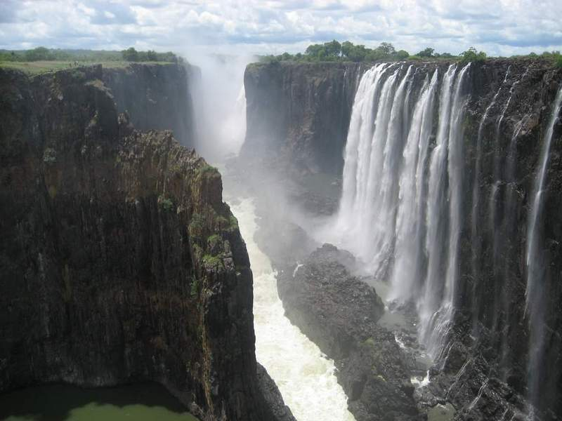

Slide 6
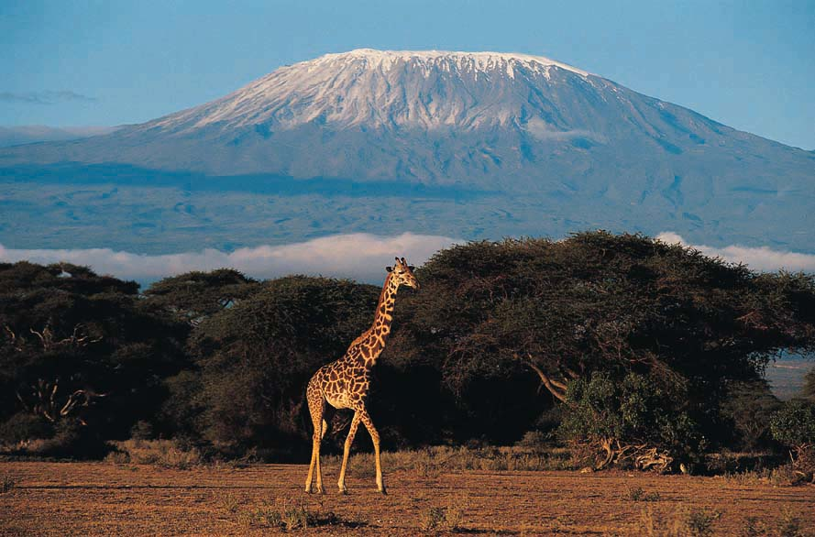

Slide 7
African Mountains
Eastern highlands
  From Ethiopia to Cape of Good Hope
    Includes Mount Kilimanjaro (Tanzania)
  RUWENZORI MOUNTAINS
    Divides Uganda and the Democratic Republic of the Congo
  DRAKENSBERG RANGE
    South Africa and Lesotho

Slide 8
The Great Rift Valley
Stretches from Syria in Southwest Asia to Mozambique in East Africa
RIFT VALLEY
  A large crack in the earth’s surface formed by shifting tectonic plates
  Millions of years ago plate movements created system of FAULTS, or fractures in the Earth

Slide 9
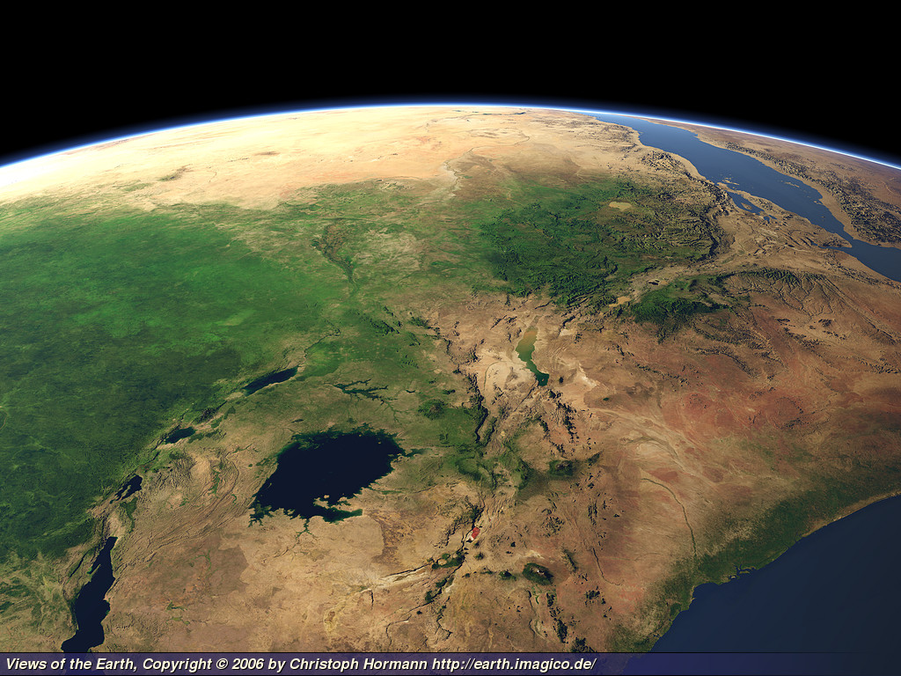

Slide 10
Water Systems
Great rivers of Africa
  Originate in high plateaus and make their way to sea
    Cannot navigate from mouth to source
Land of Lakes
  Lake Tanganyika, Lake Malawi near Great Rift Valley
  Lake Victoria – largest lake
    Second largest freshwater lake in world
    Not very deep
  Lake Chad – landlocked and shrinking

Slide 11
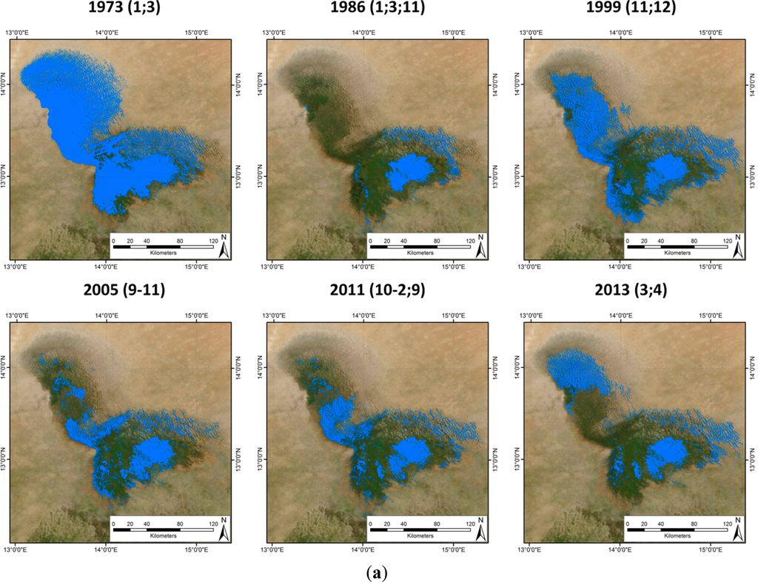

Slide 12
A Lake Meets Many Needs
Lake Volta (West Africa)
  Among largest man-made lakes in world
    Created in 1960s
    Stores water
    Supplies irrigation for farming
    Fishing
    Supplies hydroelectric power

Slide 13
River Basins
NIGER RIVER
  Main river in West Africa
    Originates in highlands of Guinea
    Empties out into Atlantic Ocean in Nigeria
      Exits into ocean via a DELTA—a triangular section of land formed by sand and silt carried downriver
    Provides transportation and important for agriculture

Slide 14
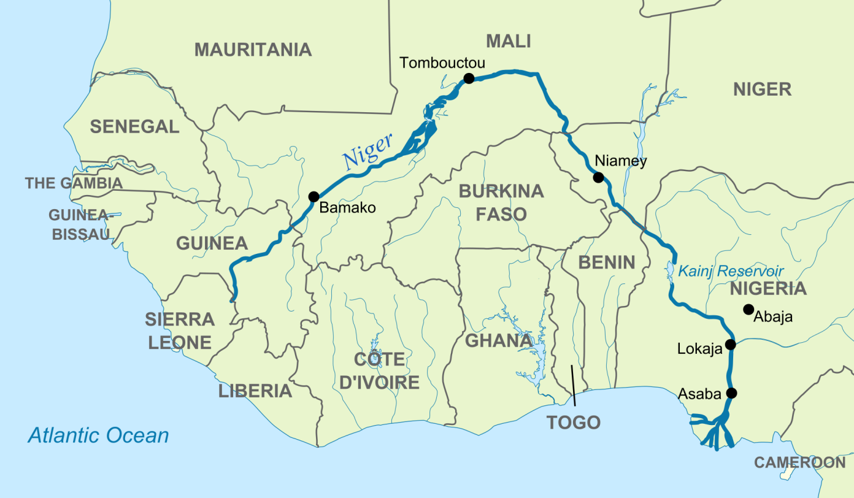
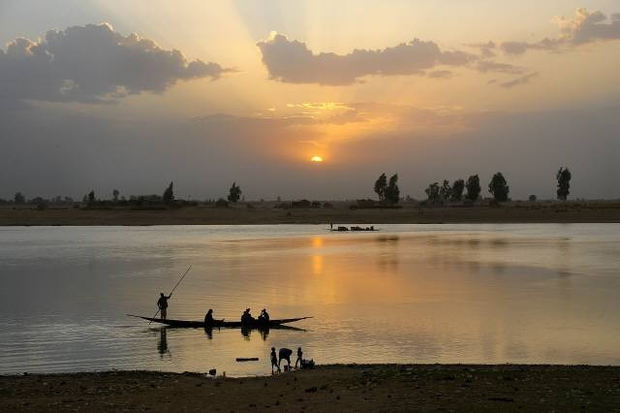
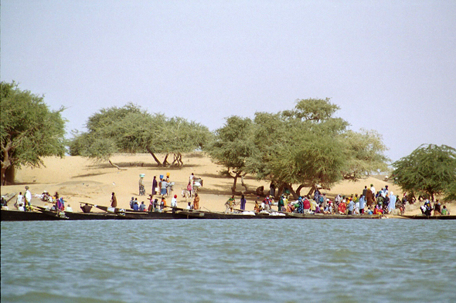

Slide 15
River Basins (continued)
ZAMBEZI RIVER
  Flows from source near Zambia-Angola border out into a delta that empties into the Indian Ocean
  Interrupted in many places by waterfalls
    Victoria Falls

Slide 16
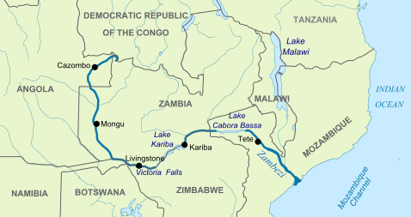
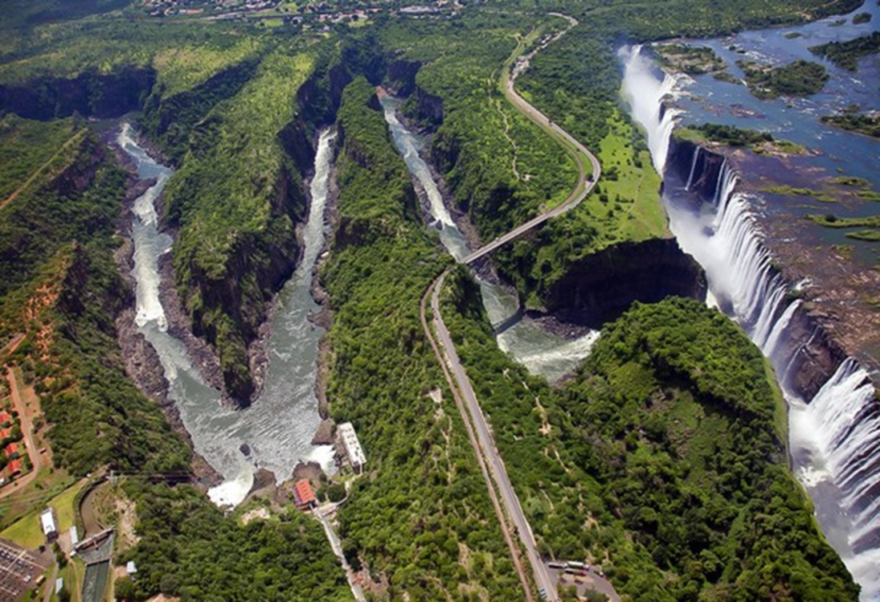
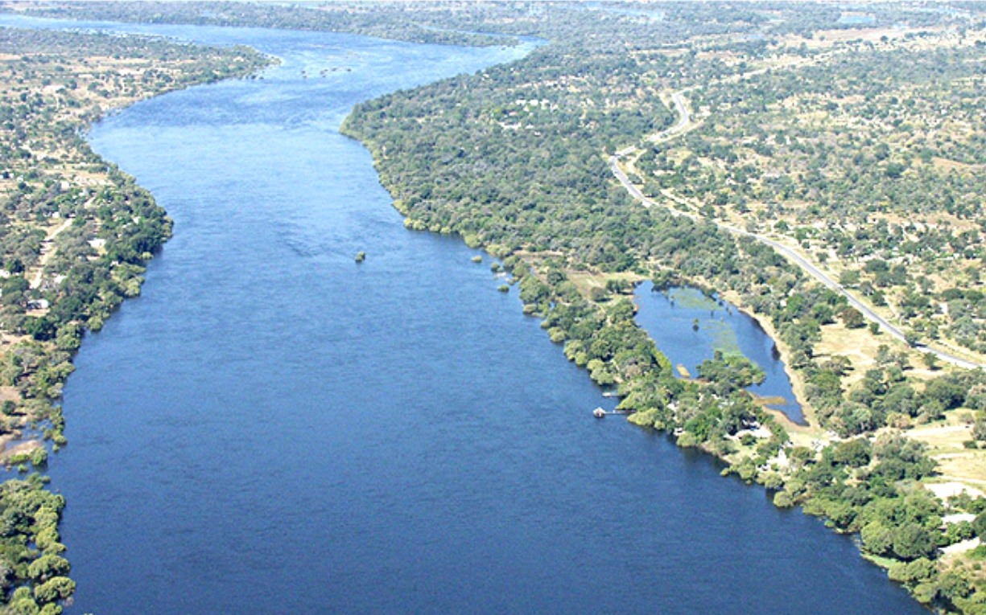

Slide 17
River Basins (continued)
Congo River
  Different than other African rivers
    Empties out into Atlantic through a deep ESTUARY—passage where freshwater from a river meets seawater
  Largest network of navigable waterways in Africa
    …but, major cataracts not far from area where it meets Atlantic Ocean
      Barrier to inland travel
        Europeans could only trade from coasts!

Slide 18
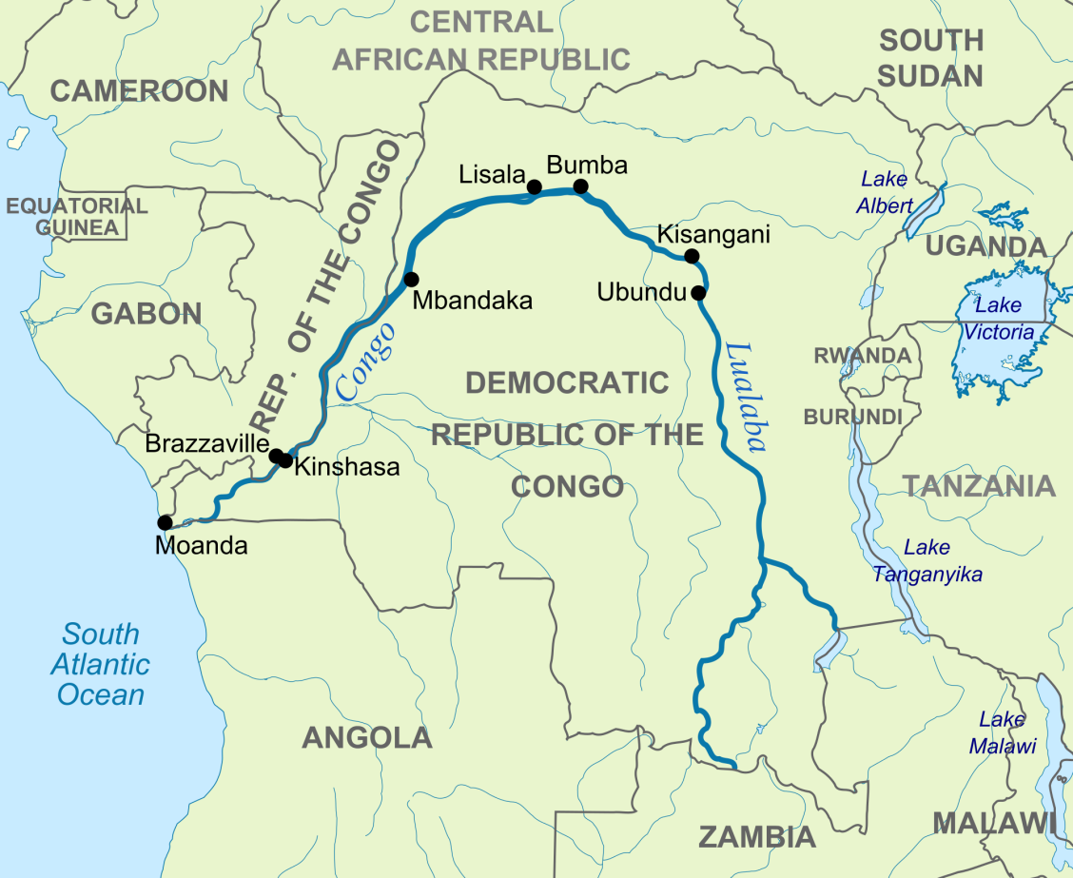
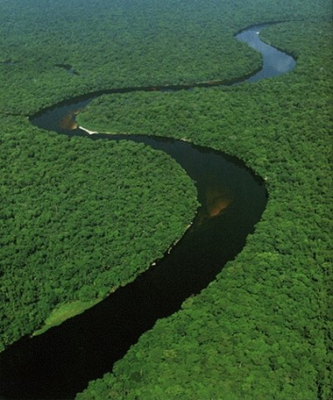

Slide 19
Resources in Africa
Niger, Gabon, & Congo
  Oil
South Africa & Botswana, Congo River
  Gold
Why can’t Africa use resources?
  Lack of $$$

Slide 20
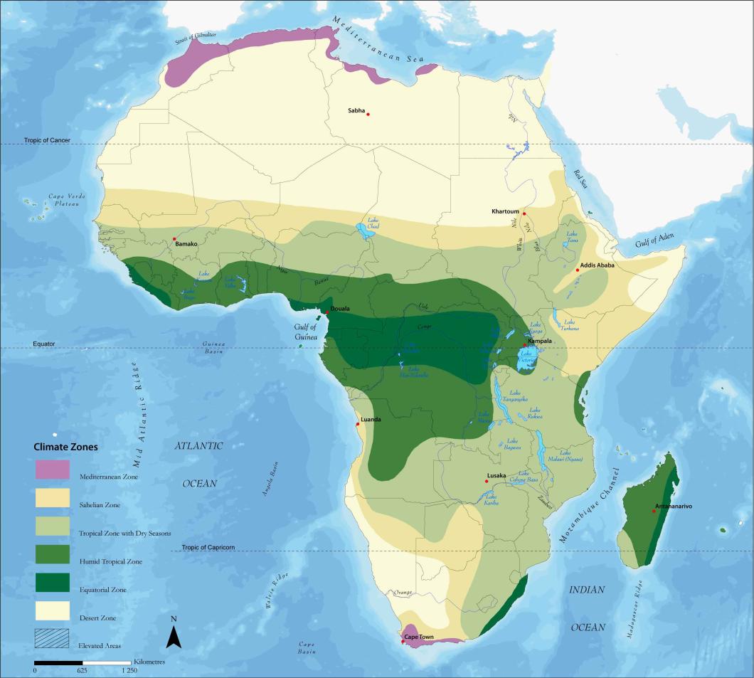
Climate and Vegetation
Variation from wind patterns, elevations, and latitude, BUT…
  Much of Africa within the TROPICS

Slide 21
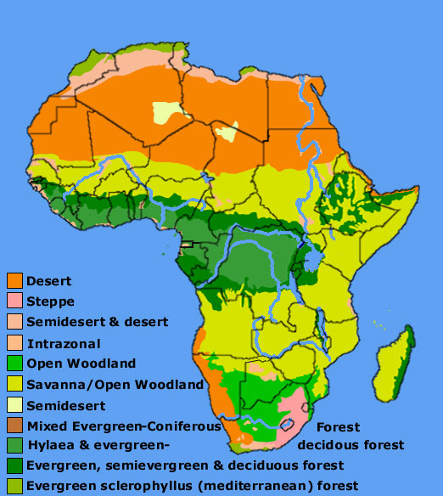

Slide 22
Tropical Rain Forest
Located near Equator
Wettest climate region in Africa
Dense forests
No real dry season
Great biodiversity
Lowest level vegetation
  Shrubs, ferns, mosses
Next level
  Trees and palms
Highest level
  Canopy of leafy trees

Slide 23
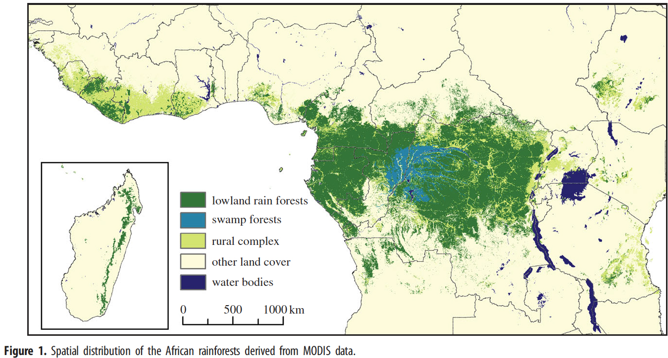

Slide 24
Crops
Heavy rains LEACH, or dissolve and carry away nutrients from the soil
Crops still can grow
  Bananas, pineapples, cocoa, tea, coffee, rubber, cotton
Clearing land
  Deforestation threatens rain forest

Slide 25
Savanna
Savanna – tropical grassland with scattered trees
  Covers almost half of continent
  Alternate wet and dry seasons
  Effects of winds
    HARMATTAN
      Hot, dry air from the Sahara coming down Northeast
        Dries up moisture from summer rains
    Southwest winds
      Brings, cool, humid air
  SARENGETI PLAIN
    One of the world’s largest savanna plains
    Many species live in protected park in Tanzania (Serengeti National Park)

Slide 26
Steppe
Moving away from the Equator
  Transforms first into savanna
  Next it becomes semiarid steppe
    In the South the steppe goes to Southern tip of continent
    Northern steppe called the SAHEL (“shore” or “edge” in Arabic)
      Band of dry land extends from Senegal to Sudan
      Low grasses, shrubs, and acacia trees
      4-8 inches annually

Slide 27
Deserts & Desertification
Past 50 years Sahel undergoing desertification
  Productive land becomes desert
  Reasons
    Climate change
    Stripping trees for firewood
    Clearing too much land for farming
    Overgrazing of livestock
African deserts
  Much of Kenya and Somalia
  Atlantic coast of Namibia
    NAMIB DESERT
  Eastern Namibia, Botswana, and part of South Africa
    KALAHARI DESERT

Slide 28
Moderate Climates
Found in coastal areas of South Africa and highlands region of East Africa
Highlands
  Often find snowfall

